Slide 1

3/25/09 Final Presentation
1st Conference on Vector Supervisors

Slide 2

Game Engines are hard!
  And complicated!
The simple pleasures
  Forgotten board games
    Vector!
Game Engine + Board Game
  = Vector Supervisor Engine (VSE)

Slide 3

Networking with 4 clients
  Human or Computer, though preferrably computer
Upholds all rules in Vector Instructions
Designed to play a tournament of 13 games
  Each game has maximum of 12 turns
Player position randomized by game
VSE play identical to Vector play
  Except the interface (cards vs. network protocol)

Slide 4

Wait for 4 connections
  Randomize game order, output randomization
Begin game loop
  State game number, remind players of positions
  Begin turn loop
    State turn number, position of Vector piece, play order for that turn
    Get directions, magnitudes
    Execute commands, output results of commands
  Determine winner, update tournament stats

Slide 5

4 main sections:
  Engine/Game Logic
  Networking
  UI/Graphics
  Testing
1 Project Manager

Slide 6

Engine
  Frank, Greg
Network
  Cole, Jake
Graphics/UI
  Aaron, Andrew, Brad
Testing
  Evan, Robert, Sara
PM
  Brad

Slide 7

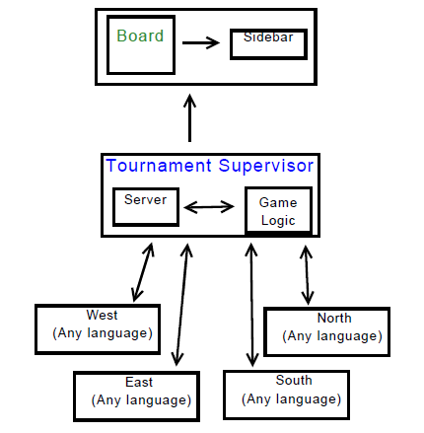

Slide 8

Engine/Logic
  Game logic, tournament regulation/specifications, input/output
Networking
  Socketing, protocol, communication
Graphics/UI
  Visual representation of game state, user tools
Testing
  Check for weaknesses, test robustness

Slide 9

Use Python
  Good networking support
  Low overhead
  Easy OOP
PyGame
  Graphics support
cxFreeze
  Creates exportable Python executable to be run on any system

Slide 10

Allowed for human-level parallel processing, with the PM serving to facilitate communication
Allowed for specialization of labor and group members
Problem was easily decomposable into sub-problems

Slide 11

Issues:
  Goals
    Vector could enter, exit goal in same turn and system would miss
  Falling off board
    Vector would continue on its path after being relocated to corner
  Loss of turns/disqualifications
    Cascading effect

Slide 12

“Tight” Formal Protocol
  Need for unambiguous, explicit protocol
Networking communications
  Message passing via TCP/IP sockets
Latency
  Not an issue given LAN play
Non-blocking I/O
  Allows for time checking, simultaneous DQs

Slide 13

Board region and Sidebar region
  Board depicts game state
  Sidebar displays game information
Receives information by message passing from Engine
Arrows drawn to show movement at end of turn
  Color-coded by player position (N,E,S,W)
Real-time vs. Slideshow mode
  As game plays, GUI displays movement
  At end of a game, arrow keys can be used to page through individual turns

Slide 14

Tasked with creating agents and conditions to test robustness
Have random agents in Python, C, and Java
  Serve as prototypes for future developers
Probabilistically create errors
  Both malformed input and timeout errors
Specified test case agents also exist for robustness of testing

Slide 15

Current focus: Functionality over Efficiency
  Fix that in future builds
More robust sever
  No cheating checking, currently
  No support for client dropout
Network latency
  On LAN, a nonpoint. Across the country?
Human interface
  Text-to-speech?
  Human-friendly GUI client (click on cards to play)

Slide 16

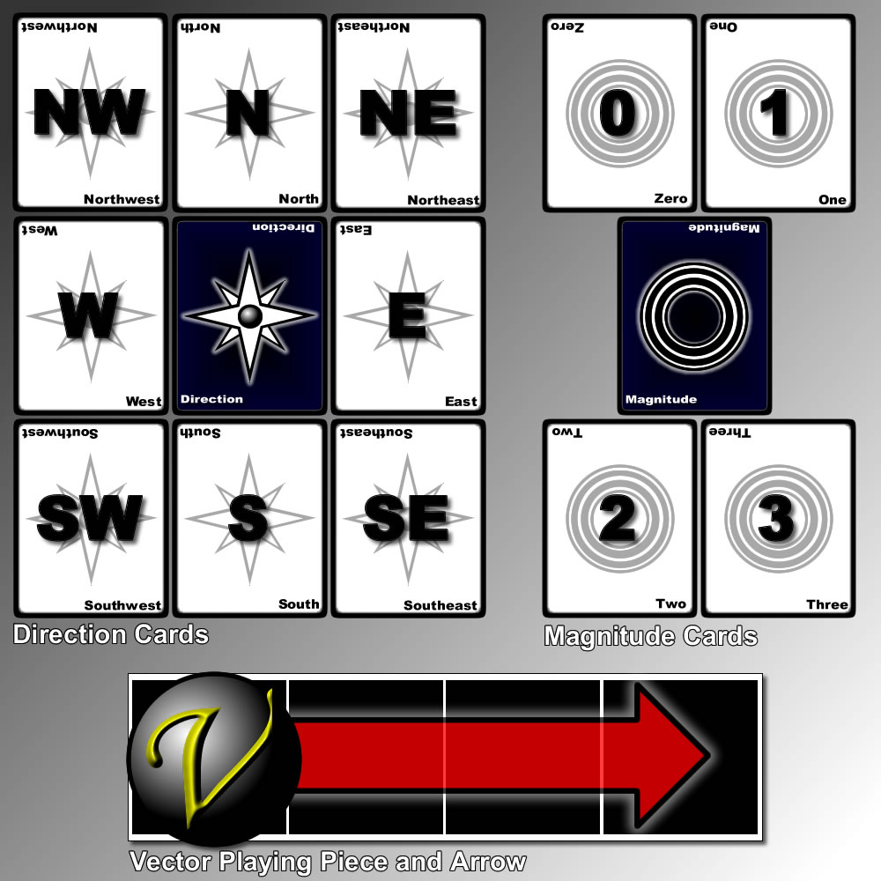

Slide 17
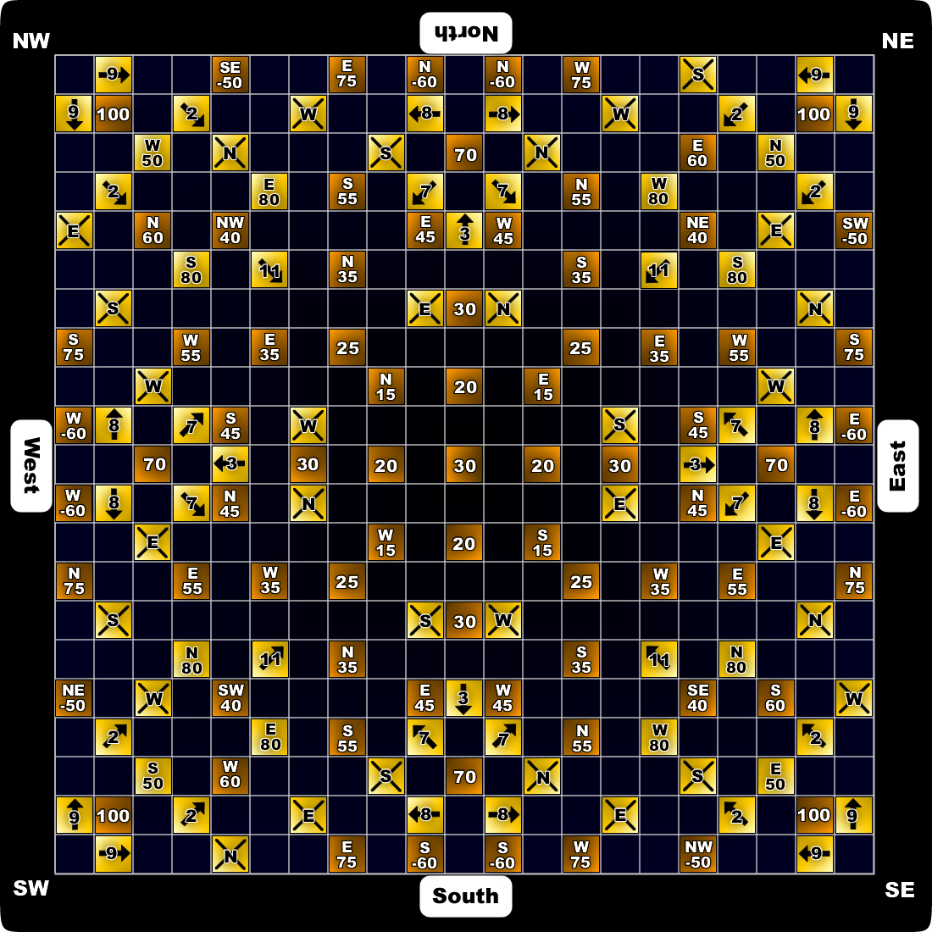

Slide 18








Slide 19

If not, Demonstration!

